Slide 1
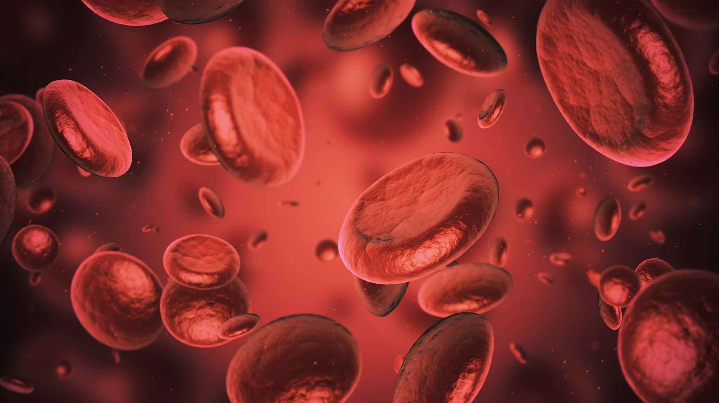
Predicting Liver Disease
A Quick Data Science Showcase

Slide 2
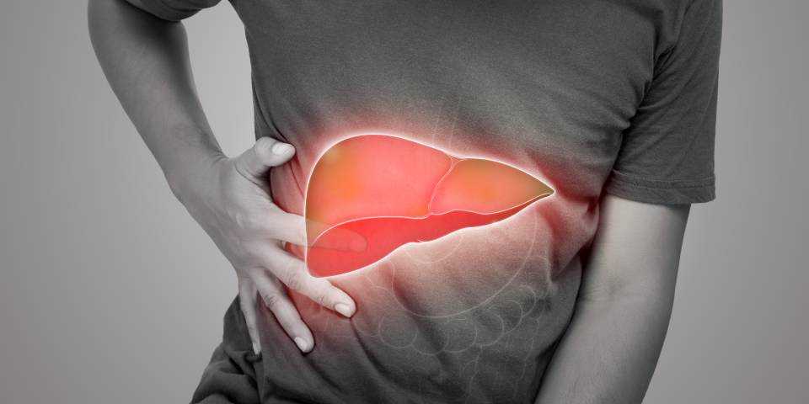
Dataset
Variables
Age: Range: 20 to 80 years.
Gender: Male (0) or Female (1).
BMI (Body Mass Index): Range: 15 to 40.
Alcohol Consumption: Range: 0 to 20 units per week.
Smoking: No (0) or Yes (1).
Genetic Risk: Low (0), Medium (1), High (2).
Physical Activity: Range: 0 to 10 hours per week.
Diabetes: No (0) or Yes (1).
Hypertension: No (0) or Yes (1).
Liver Function Test: Range: 20 to 100.
Diagnosis: Binary indicator (0 or 1) of liver disease presence.
Dataset Composition
Size: 1500 records.
Composition: Features encompassing demographic, lifestyle, and health indicators.

